Slide 1
Bayes classifier
9 Sep, 2021
Dinesh Babu J, IIITB

Slide 2
Naïve Bayes classifier
Probabilistic classifiers estimate
Use Bayes theorem
Use Naïve assumption, given class label the features are independent (class conditional independence)
$$P(C=C_{k}|x)$$
$$P(C=C_{k}|x)=\frac{p(x_{1}x_{2}|C=C_{k})P(C=C_{k})}{p(x)}$$
$$P(C=C_{k}|x)=\frac{p(x_{1}|C=C_{k})p(x_{2}|C=C_{k})P(C=C_{k})}{p(x)}$$

Slide 3
Bayes classifier
Probabilistic classifiers estimate
Given the 2D features, we want to estimate the probability that the class label C is say
C₁(i.e. MALE) or C₂(i.e. FEMALE)
Use Bayes theorem, assuming 2D feature vector
$$P(C=C_{k}|x)$$
$$P(C=C_{k}|x)=\frac{p(x_{1}x_{2}|C=C_{k})P(C=C_{k})}{p(x)}$$

Slide 4
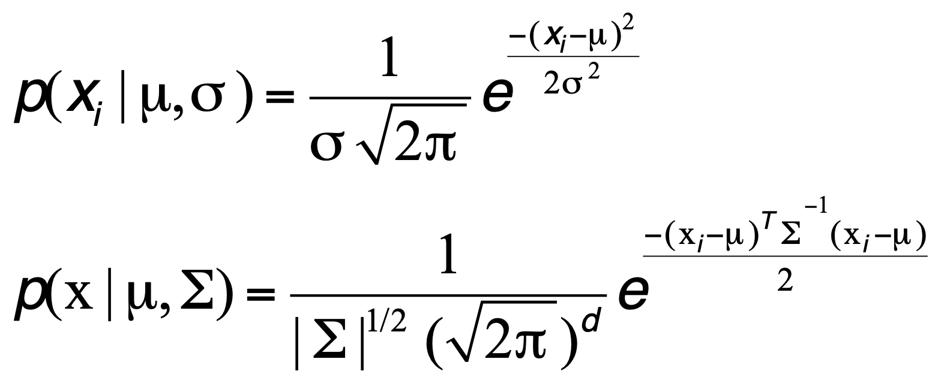
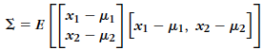
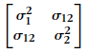
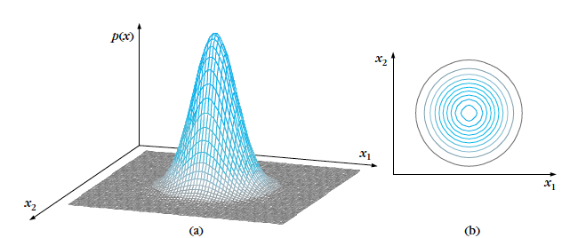
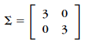
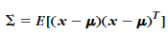
Multivariate Gaussian

Slide 5
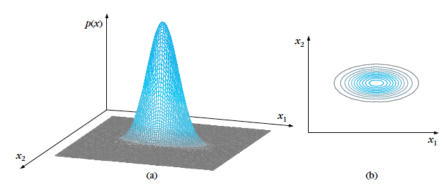
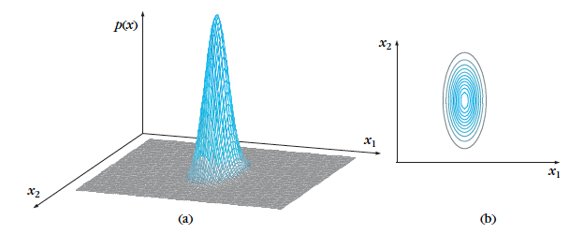

Slide 6
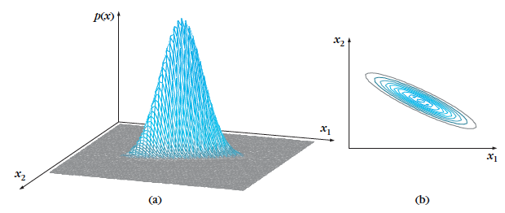
Reading: B3. Pages 20-24

Slide 7
REFERENCES
MLE Gaussian (https://towardsdatascience.com/maximum-likelihood-estimation-explained-normal-distribution-6207b322e47f)
MLE Gaussian (https://www.youtube.com/watch?v=Dn6b9fCIUpM)
Gaussian Naive Bayes (https://en.wikipedia.org/wiki/Naive_Bayes_classifier)
Gaussian Naive Bayes (https://www.youtube.com/watch?v=H3EjCKtlVog)
Bayes classifier: Additional video (https://www.youtube.com/watch?v=54wfthrhwLQ)
MVG (https://www.youtube.com/watch?v=eho8xH3E6mE)

Slide 8
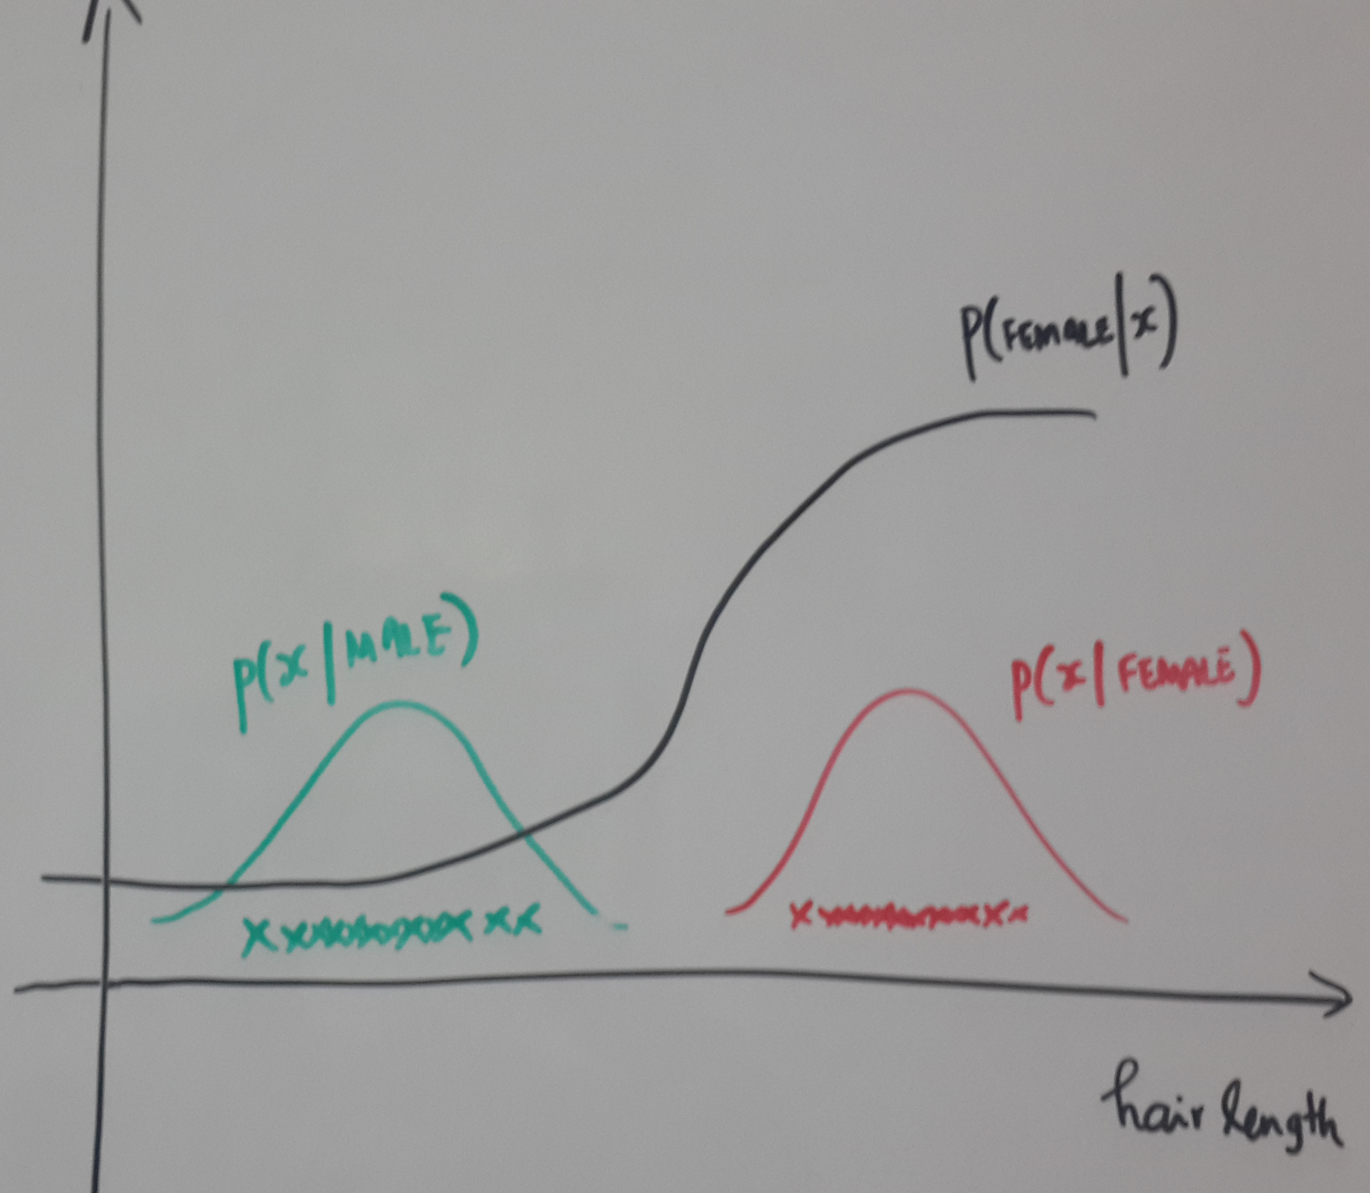
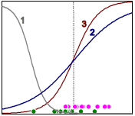
Probabilistic models: Generative vs Discriminative
Generative models
$$P(C=C_{k}|x)=\frac{p(x|C=C_{k})P(C=C_{k})}{p(x)}$$
Discriminative models
$$P(C=C_{k}|x)$$

Slide 9
logistic regression
Notes:
Welcome to the lecture on ””

Slide 10
Probabilistic classifiers
Probabilistic classifiers estimate
Given x the features, we want to estimate the probability that the class label C is say
C₁(i.e. MALE) or C₂(i.e. FEMALE)
$$P(C=C_{k}|x)$$

Slide 11
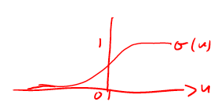
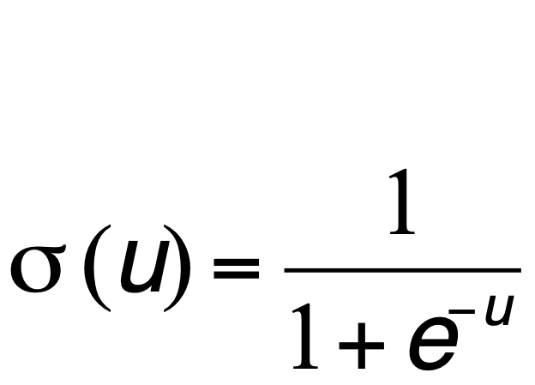
Logistic Sigmoid function
Maps real line to probability
Hence used to model posterior probability
Final goal: Feature as input and output is posterior probability

Slide 12
Logistic Sigmoid function
$$P(FEMALE|x;a,b)=σ(ax+b)$$
Final goal: Feature as input and output is posterior probability
Step 1: Take linear combination of features (similar to Linear Regression)
Step 2: Apply sigmoid function

Slide 13
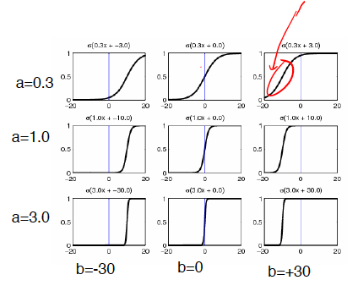
Logistic sigmoid function

Slide 14
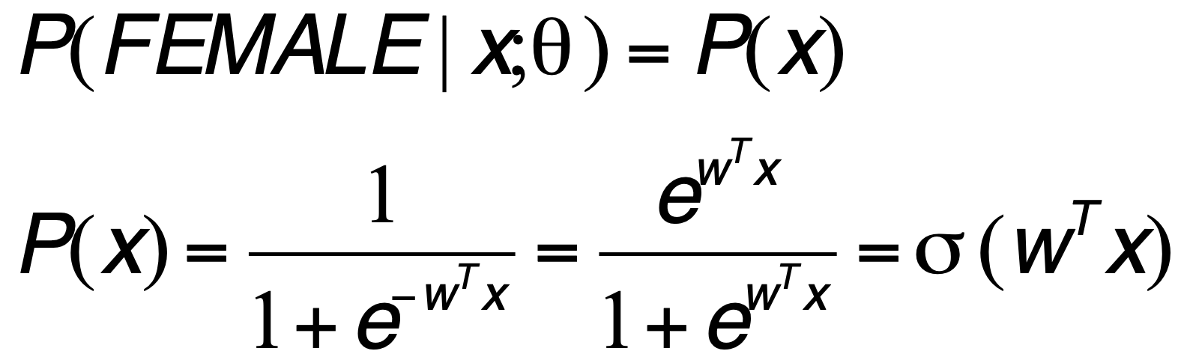
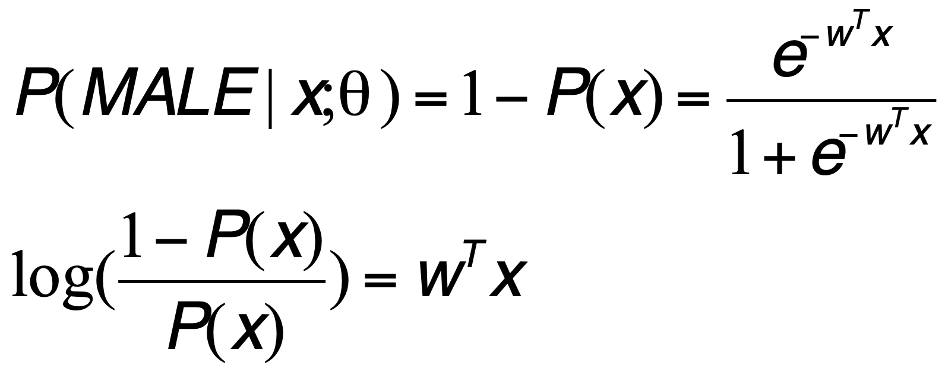
Some properties

Slide 15

Learning and Inference algorithm
Learning Algorithm
Given the training data, find the parameter vector w (What is the cost function?)
Inference Algorithm
You have learnt w, x is given, compute p(x)

Slide 16
Agenda
Logistic regression – model and model parameters
MLE estimation of Logistic regression parameters

Slide 17
Bernoulli
{F,M, M, F….} N observations
Assume comes from a Bernoulli distribution
What is the parameter to be estimated?
p = P(FEMALE)
1-p = P(MALE)
How to find p?

Slide 18
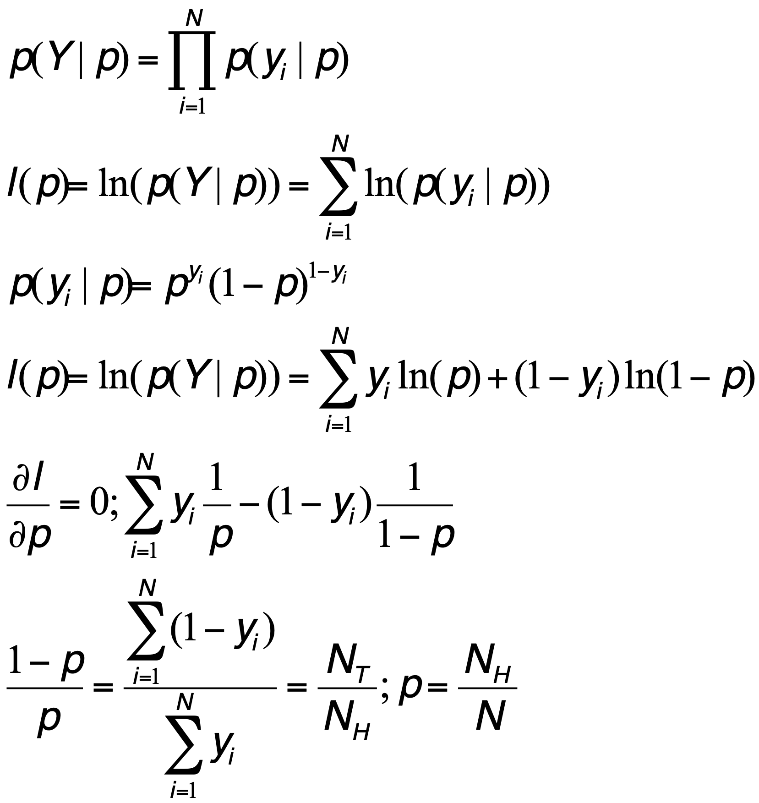
MLE – Bernoulli distribution

Slide 19
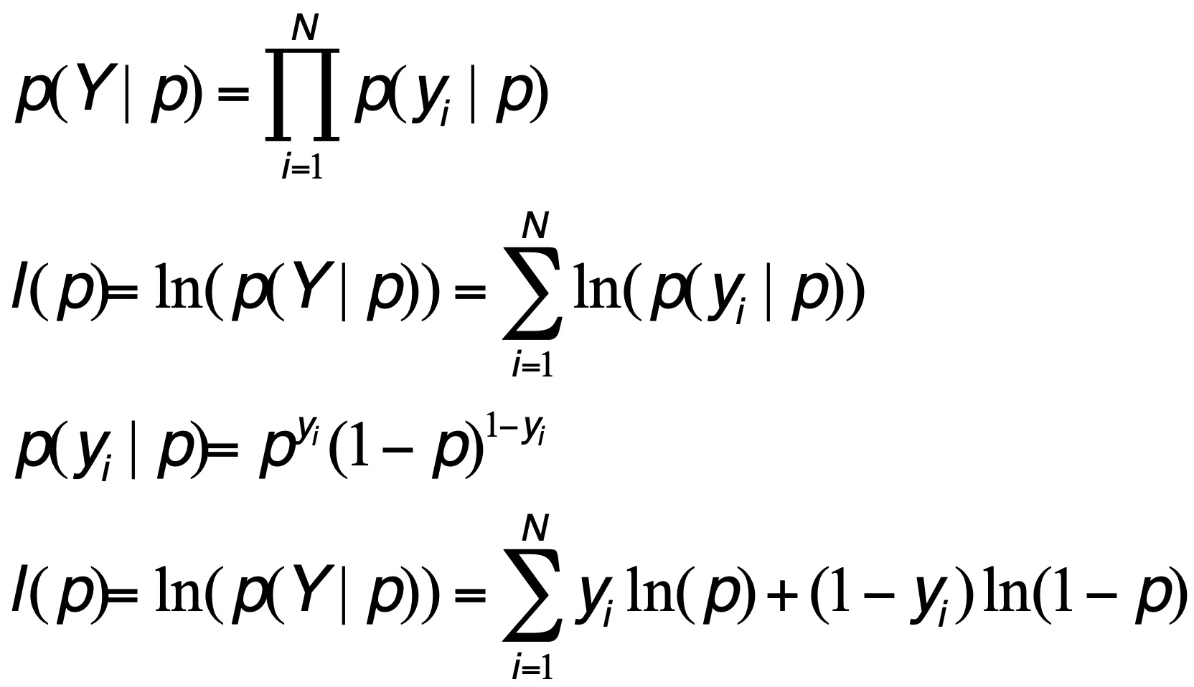
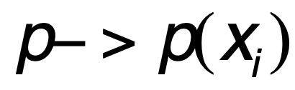
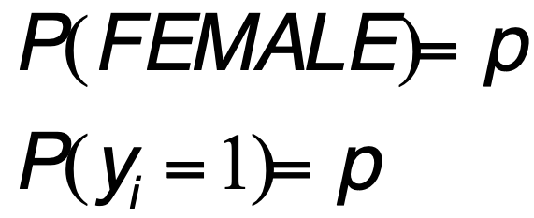
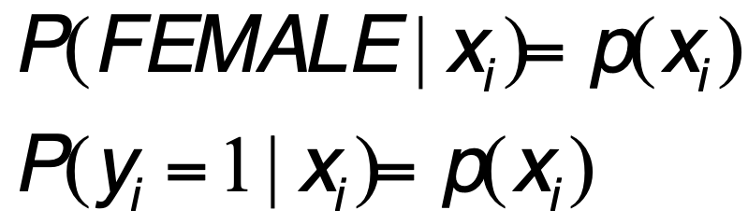
Class label – Bernoulli whose parameter depends on x

Slide 20
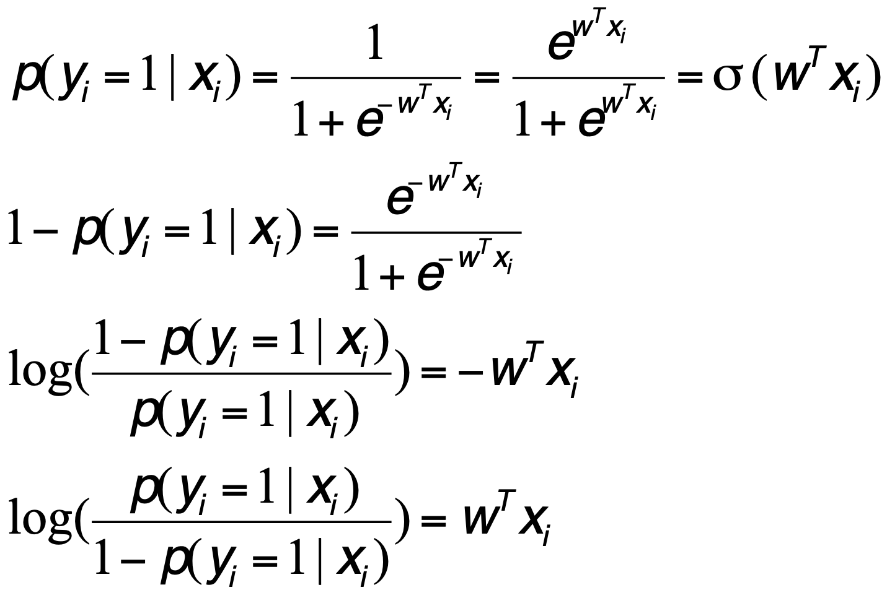
Posteriori using Logistic Function

Slide 21
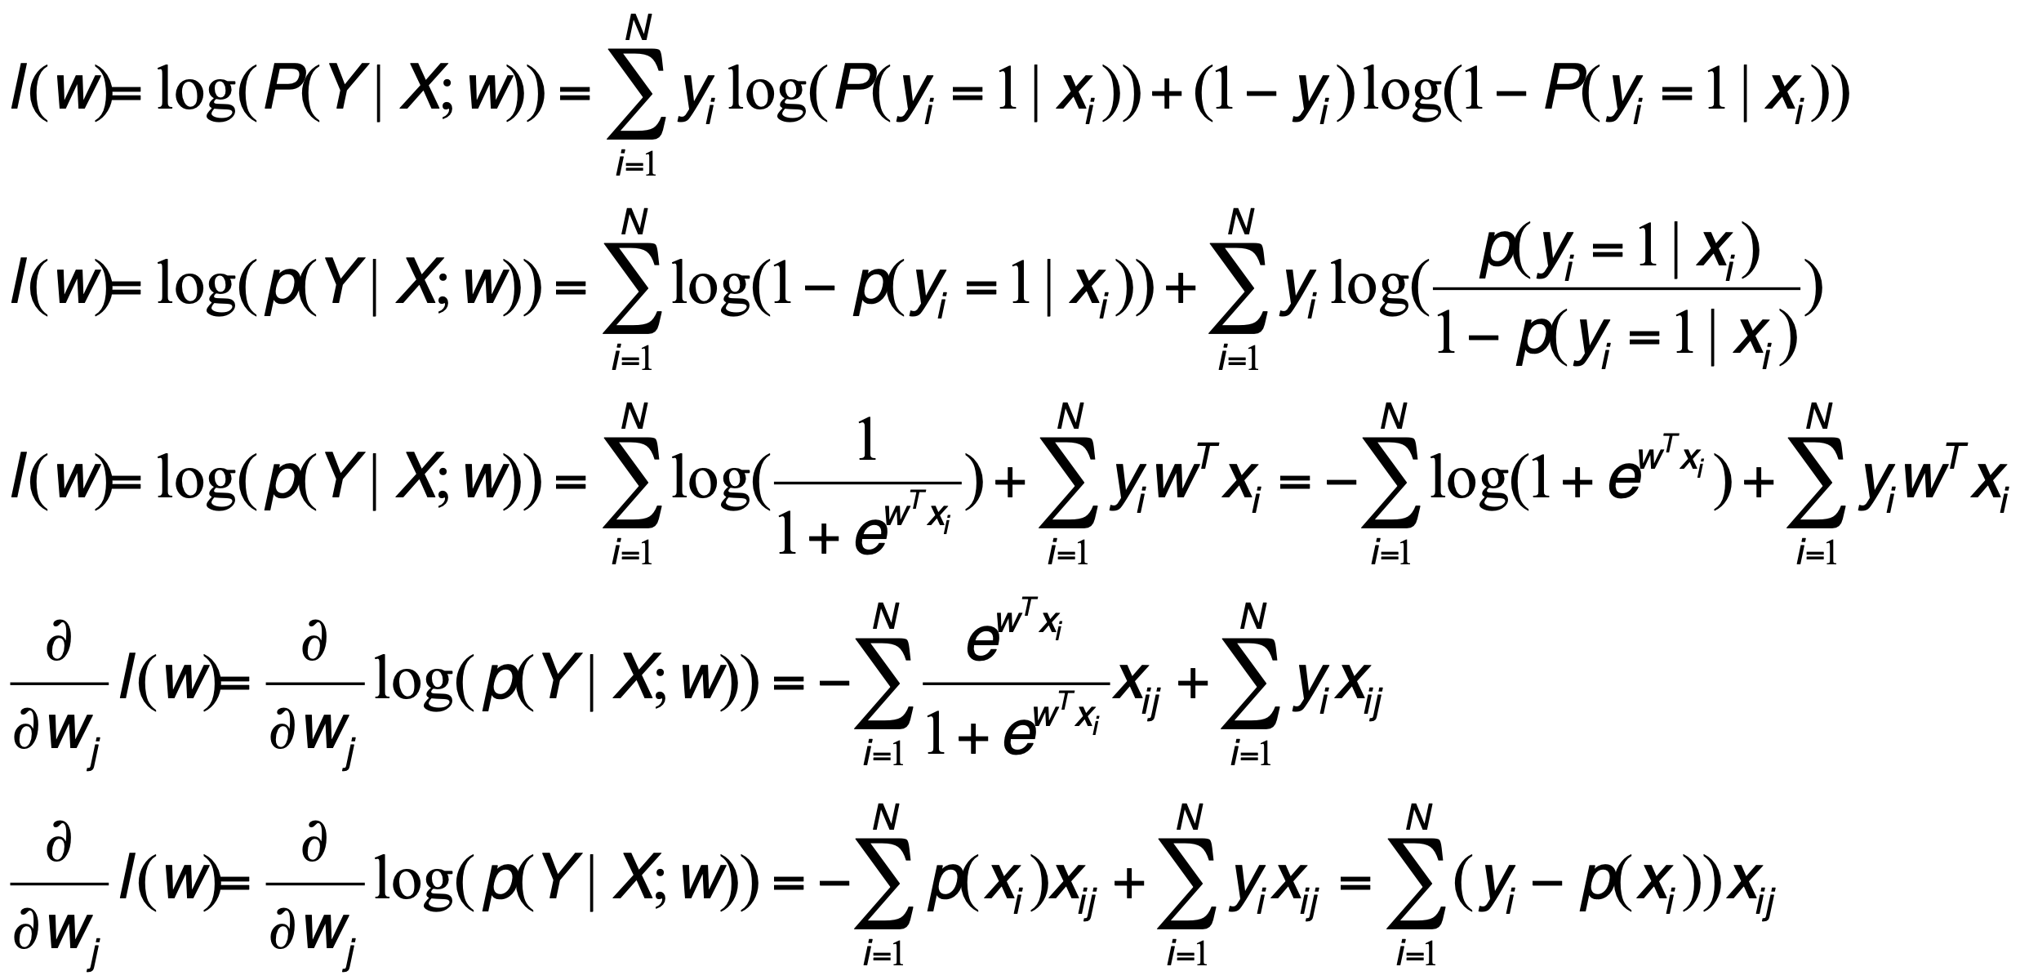
MLE (LR)

Slide 22
MLE (LR)

Slide 23
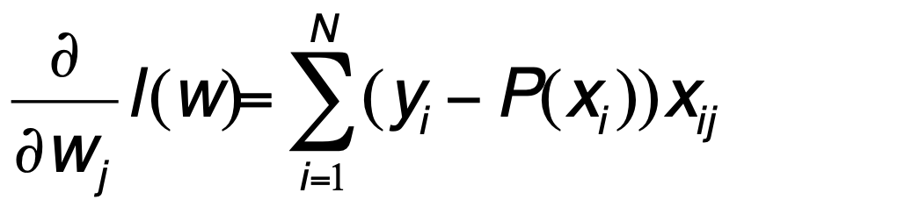
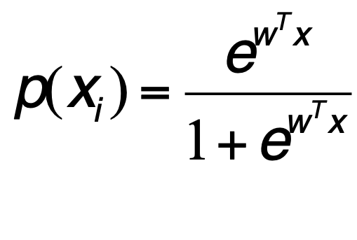
LR cost function – gradient

Slide 24
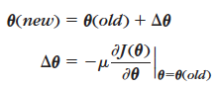
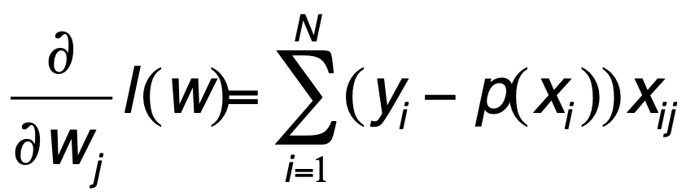
Gradient Descent
NOTE: HERE WE NEED TO DO GRADIENT ASCENT
MINIMIZATION – GRADIENT DESCENT
MAXIMIZATION – GRADIENT ASCENT

Slide 25
Conclusion
Logistic Regression
Classifier: Logistic idea + Linear Regression
Discriminative model (vs Generative model)
Parameters – feature weights
Estimation – ML estimation

